Slide 1
A Better POV fan
By Ben Kepner

Slide 2
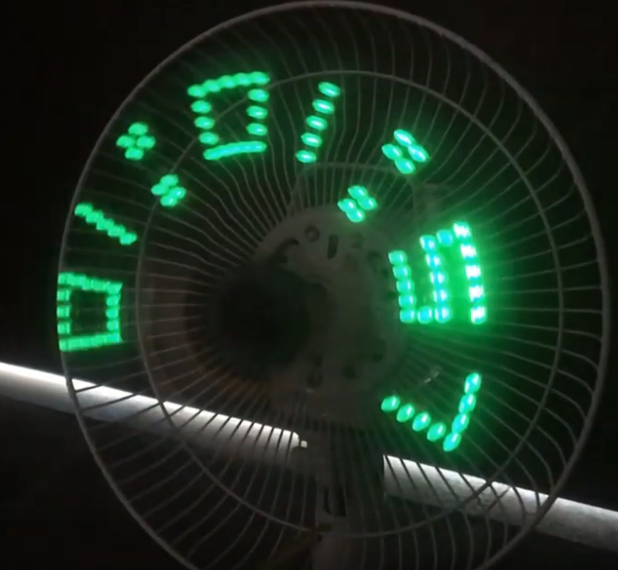
What is a POV fan
Persistence of vision (POV)

Slide 3
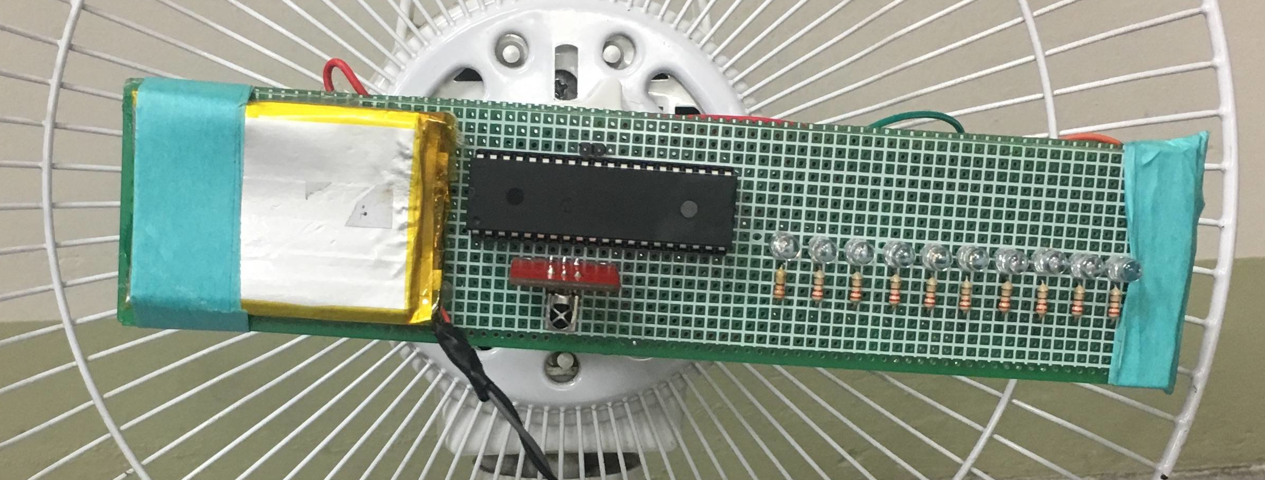
The problem
Current POV fans use problematic power supply methods
Battery
Slip ring

Slide 4
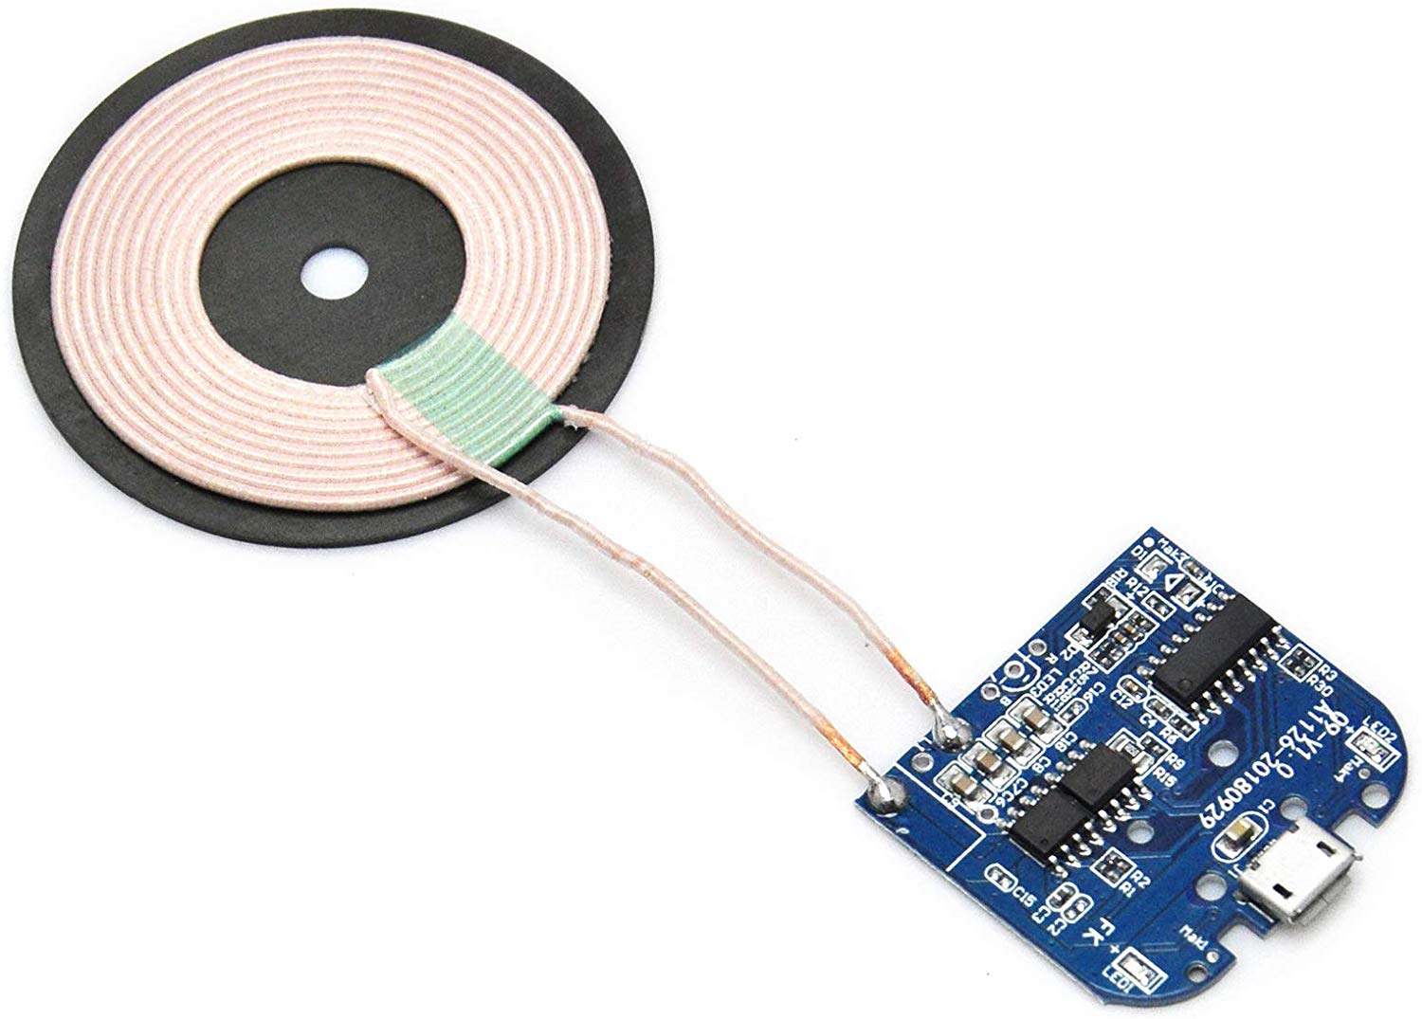
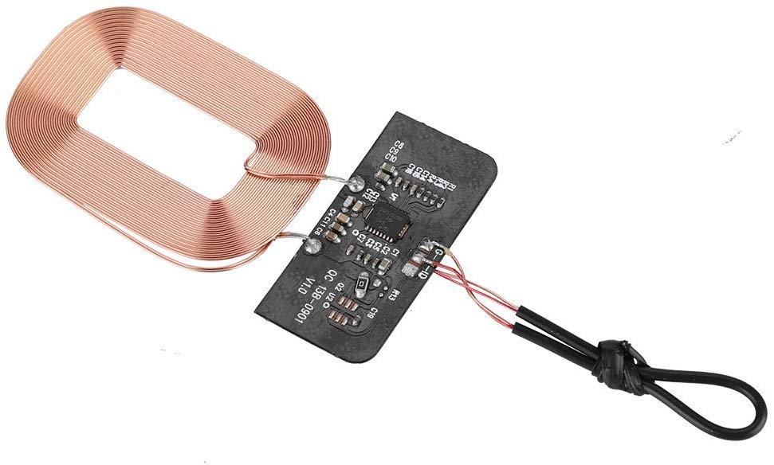
Solution
Use wireless charging!

Slide 5
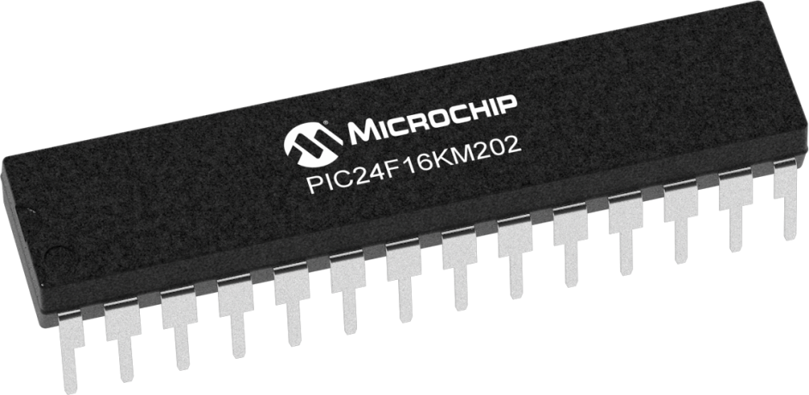
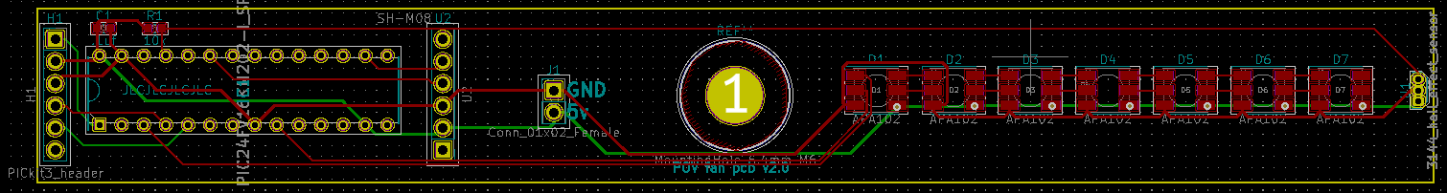
Implementation
Custom PCB
PIC24
3D printed housing
Brushless motor
RGB LEDs
BLE UART chip

Slide 6
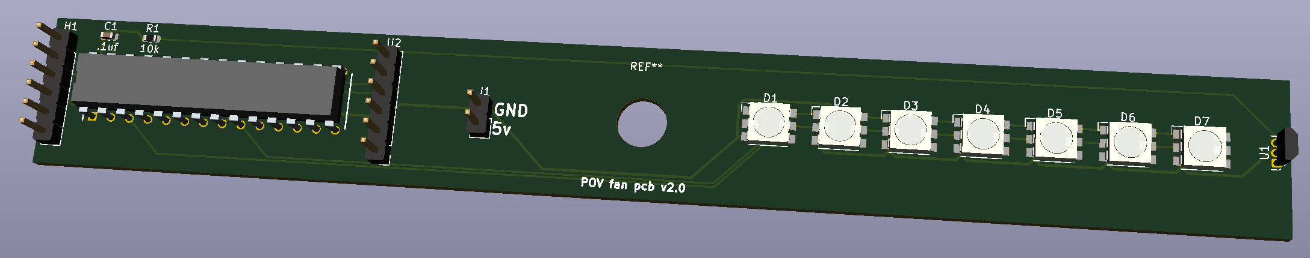
Implementation
Custom PCB
PIC24
3D printed housing
Brushless motor
RGB LEDs
BLE UART chip

Slide 7
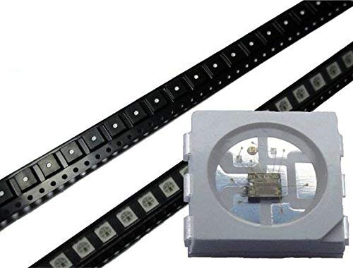
Implementation
Custom PCB
PIC24
3D printed housing
Brushless motor
RGB LEDs
BLE UART chip

Slide 8
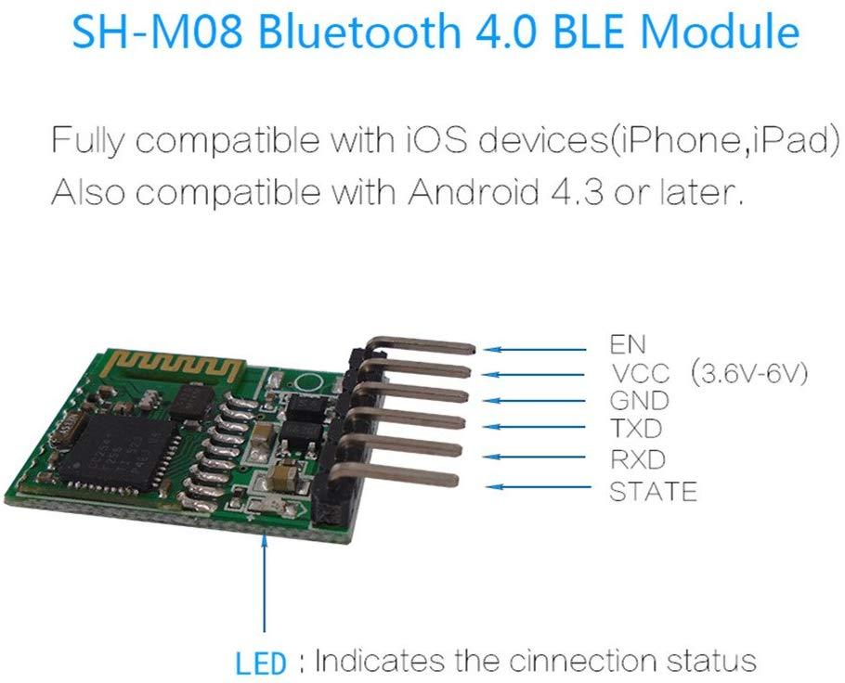
Implementation
Custom PCB
PIC24
3D printed housing
Brushless motor
RGB LEDs
BLE UART chip

Slide 9
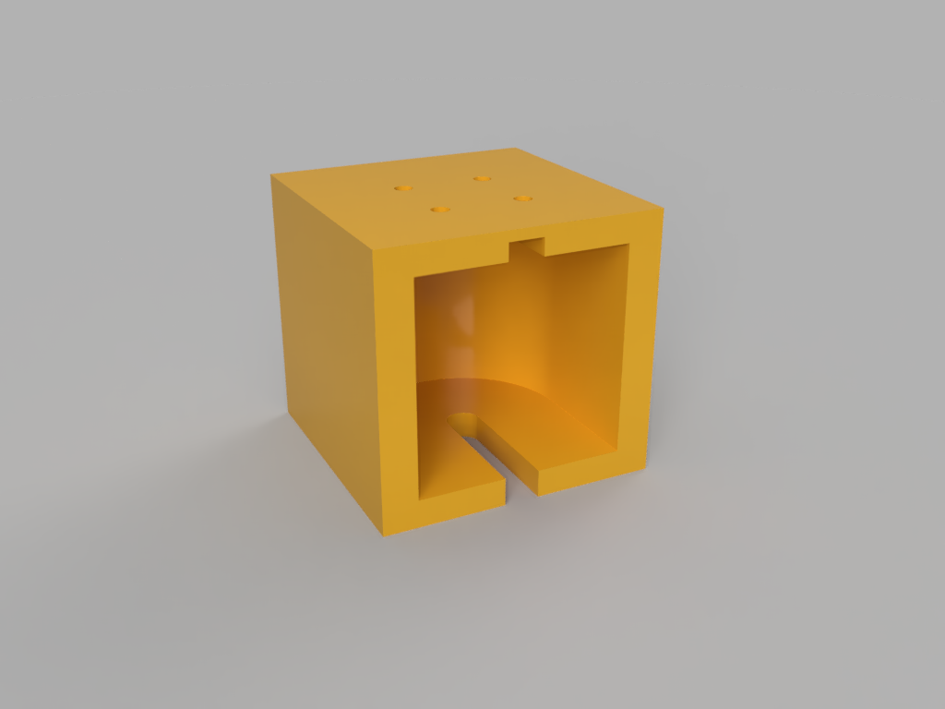
Implementation
Custom PCB
PIC24
3D printed housing
Brushless motor
RGB LEDs
BLE UART chip

Slide 10
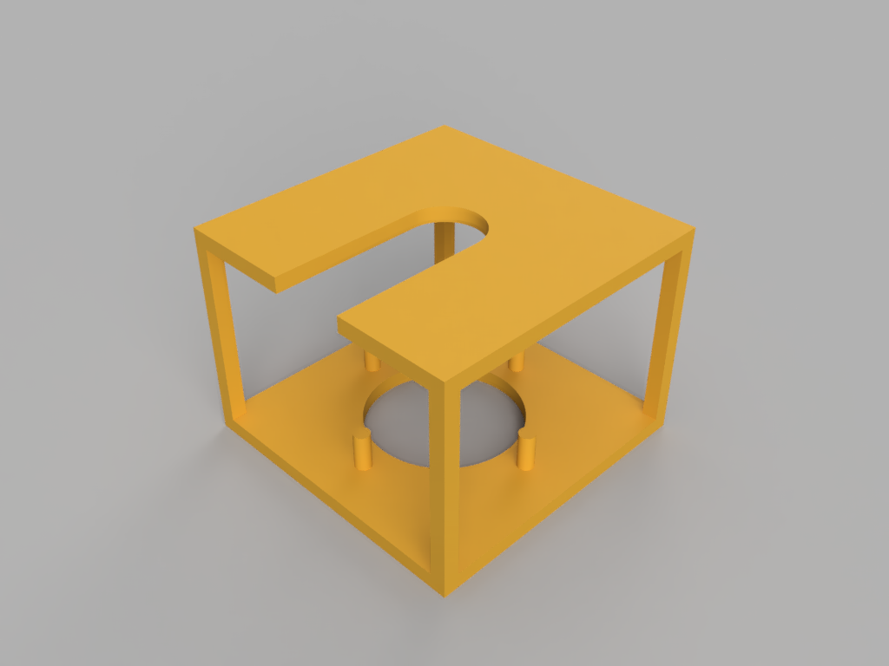
Implementation
Custom PCB
PIC24
3D printed housing
Brushless motor
RGB LEDs
BLE UART chip

Slide 11
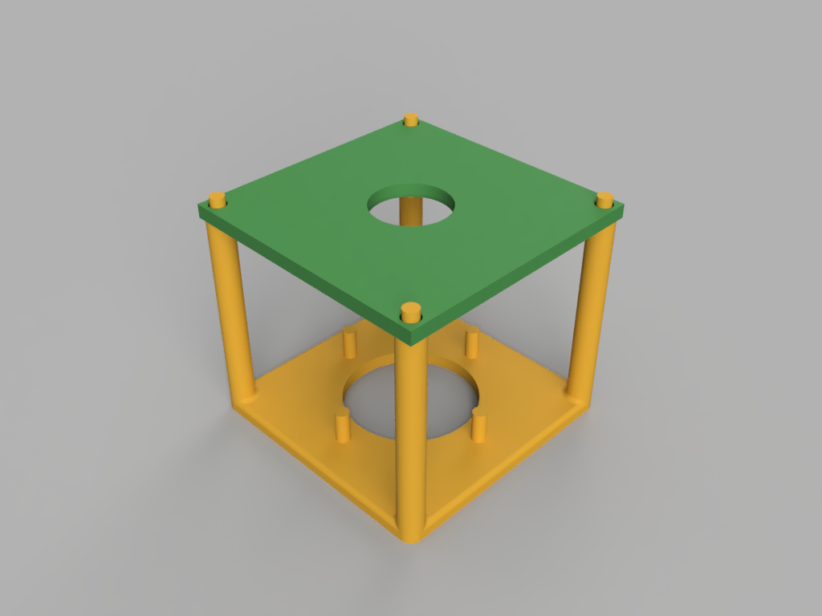
Implementation
Custom PCB
PIC24
3D printed housing
Brushless motor
RGB LEDs
BLE UART chip

Slide 12
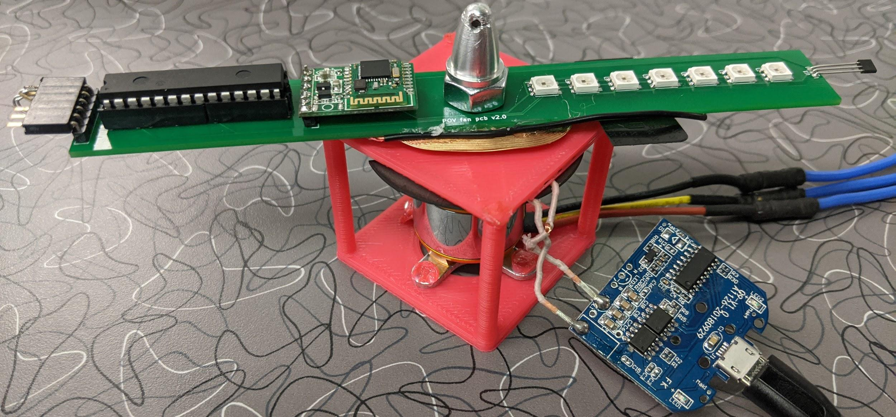
Implementation
Custom PCB
PIC24
3D printed housing
Brushless motor
RGB LEDs
BLE UART chip

Slide 13
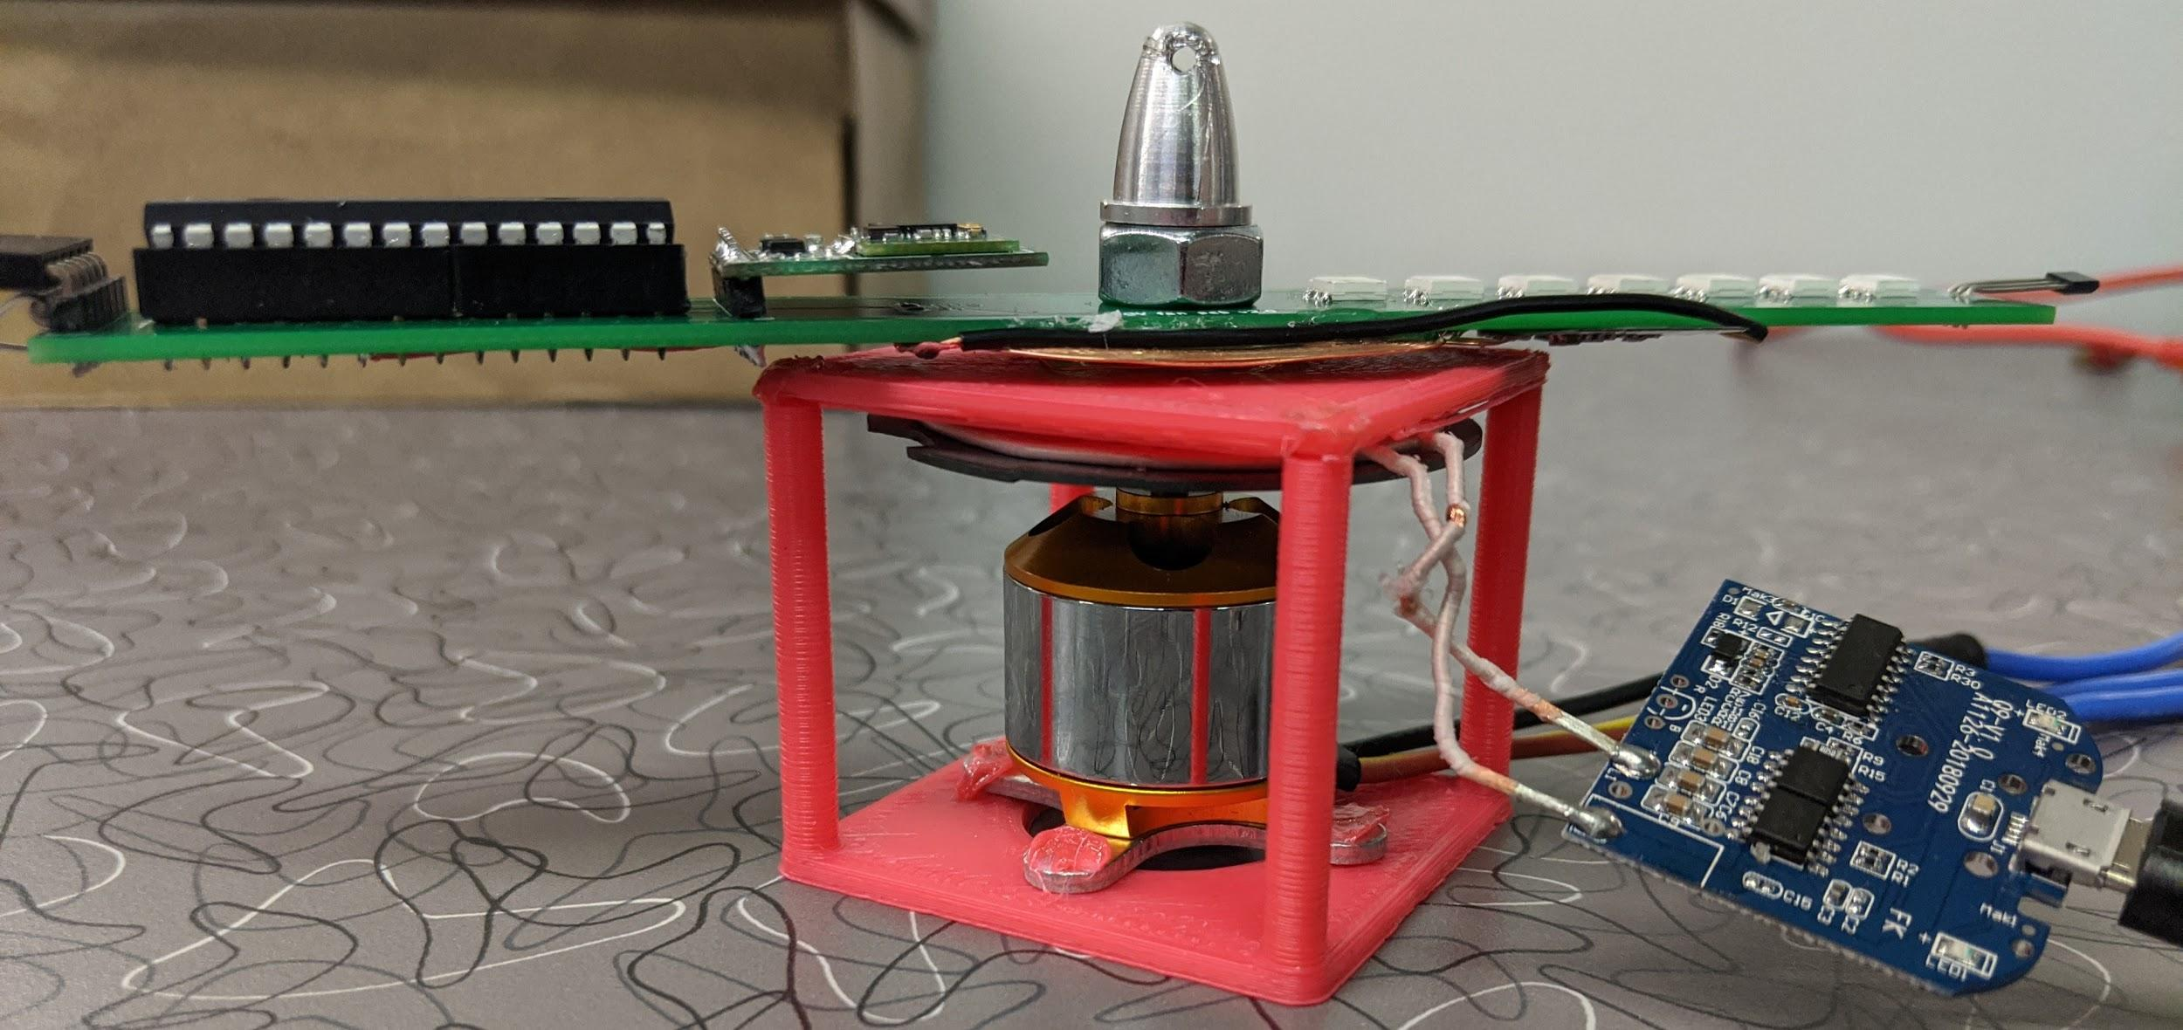
Implementation
Custom PCB
PIC24
3D printed housing
Brushless motor
RGB LEDs
BLE UART chip

